Slide 1

State of play of the debate on the Multi-Annual Financial Framework
Presentation for the ALDE Group meeting
22.03.2018
Thomas Wobben

Slide 2
Overview
Some basics with regard to the MFF
Current state of debate in the EU institutions
  European Commission
  Council
  European Parliament
Plans of the CoR

Slide 3
Some basics

Slide 4
Specific decision making
Article 312 TFEU
1. The multiannual financial framework shall ensure that Union expenditure develops in an orderly manner and within the limits of its own resources.
It shall be established for a period of at least five years. The annual budget of the Union shall comply with the multiannual financial framework.
2. The Council, acting in accordance with a special legislative procedure, shall adopt a regulation laying down the multiannual financial framework.
The Council shall act unanimously after obtaining the consent of the European Parliament, which shall be given by a majority of its component members.
…..

Slide 5
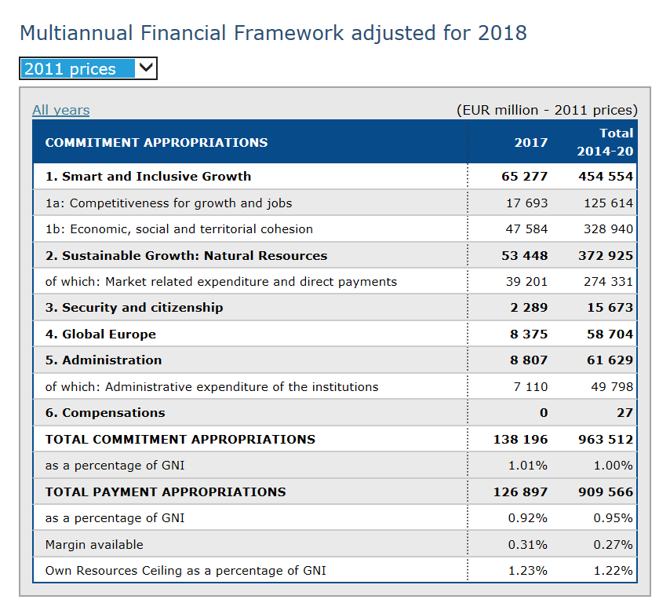
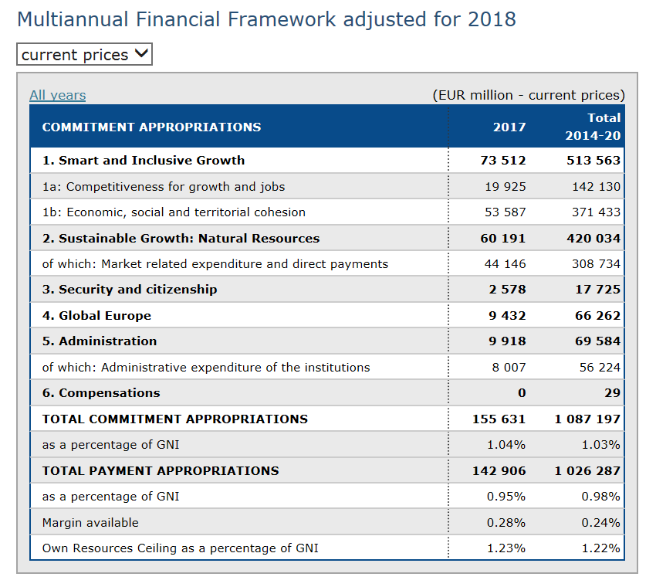
Current prices or fixed prices!

Slide 6
Cohesion Policy in current prices – big changes
Year | 2011 | 2012 | 2013 | 2014 | 2015 | 2016 | 2017 | 2018 | 2019 | 2020 | 2021 | 2022 | 2023 | 2024 | 2025 | 2026 | 2027
Inflator | 1,00 | 1,02 | 1,04 | 1,06 | 1,08 | 1,10 | 1,13 | 1,15 | 1,17 | 1,20 | 1,22 | 1,24 | 1,27 | 1,29 | 1,32 | 1,35 | 1,37
 |  |  |  | Programming Period 2014-2020 |  |  |  |  |  |  | Programming Period 2021-2028
Cohesion Policy allocation (2011) |  |  |  | 34,10 | 55,72 | 46,04 | 47,58 | 48,03 | 48,51 | 48,92 | 46,9 | 46,9 | 46,9 | 46,9 | 46,9 | 46,9 | 46,9
Total (2011) |  |  |  |  |  |  |  |  |  | 328,9 |  |  |  |  |  |  | 328,9
Cohesion Policy allocation (current prices) |  |  |  | 36,19 | 60,30 | 50,83 | 53,58 | 55,18 | 56,84 | 58,47 | 57,51 | 58,66 | 59,83 | 61,03 | 62,25 | 63,50 | 64,77
Total (current prices) |  |  |  |  |  |  |  |  |  | 371,4 |  |  |  |  |  |  | 427,5

Slide 7
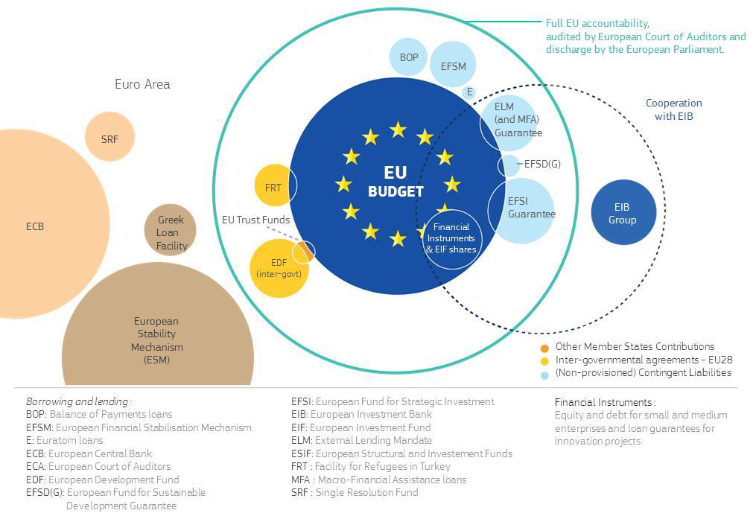
What is in the EU budget and what is out?
Transparency
Role of the EP
Pressure on the overall Budget

Slide 8
We are all winners

Slide 9
Plans of the European Commission

Slide 10
State of play – Timetable within the Commission
14.02. Communication on the future MFF and the Leaders debate
02.05. Adoption of the Commission proposal for the next MFF
29.05. Adoption of the draft legal actions for all EU programmes (big bang!)
    2nd/3rd week of April Commissioner Oettinger will organise the hearings with Commissioners and their Directors-General to discuss the key parameters and figures for the programmes in the next Multiannual Financial Framework.
    Secretariat-General and the Directorate-General for Budget will prepare draft policy fiches describing for each major programme its European added value, objectives, delivery modes and simplification efforts, as well as complementarities with other programmes and financing provided at national or regional level.
    Additional preparatory meetings will be organised if needed before the hearings

Slide 11
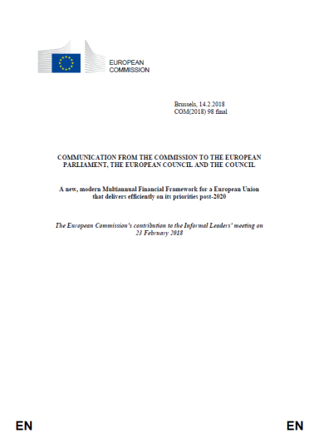
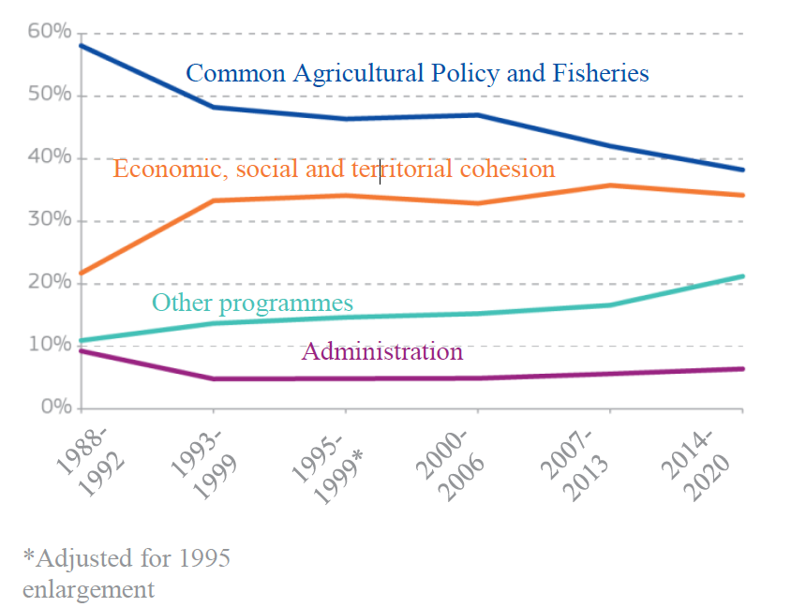
Proposal of the European Commission 14.02.2018
Current ERASMUS+ Allocation: 14 billion EUR

Slide 12
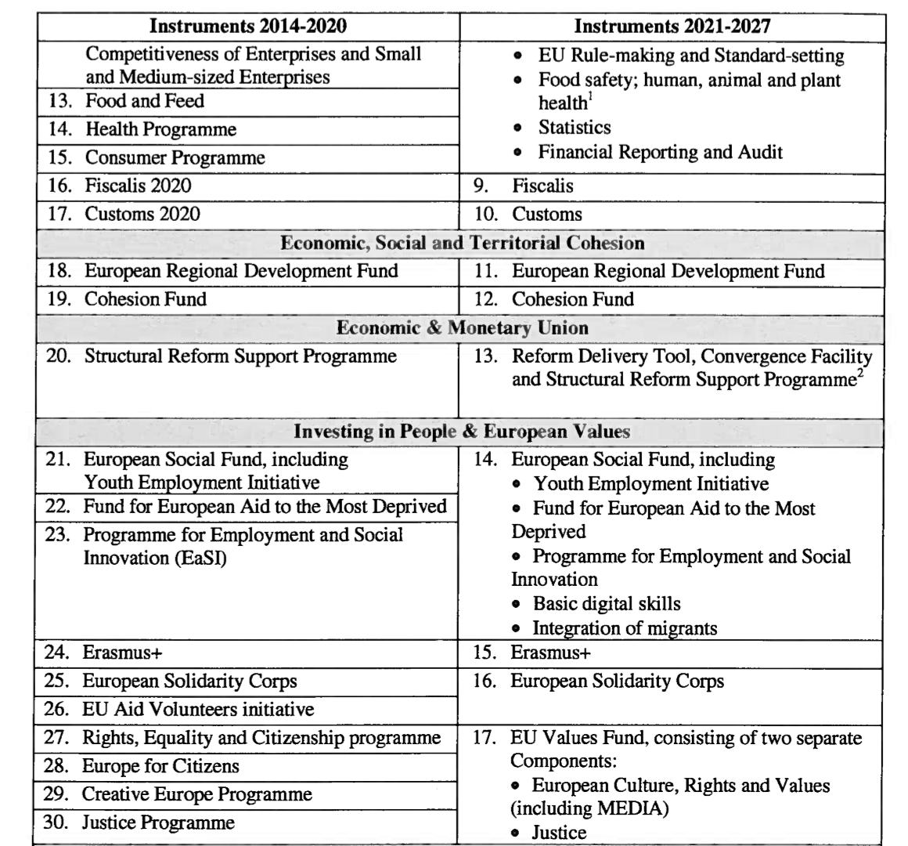
New structure of the EU Programmes
Commission proposes to reduce the number of EU Programmes from 67 to 37!
Substantial changes i.e. for the European Social Fund or the external instruments

Slide 13
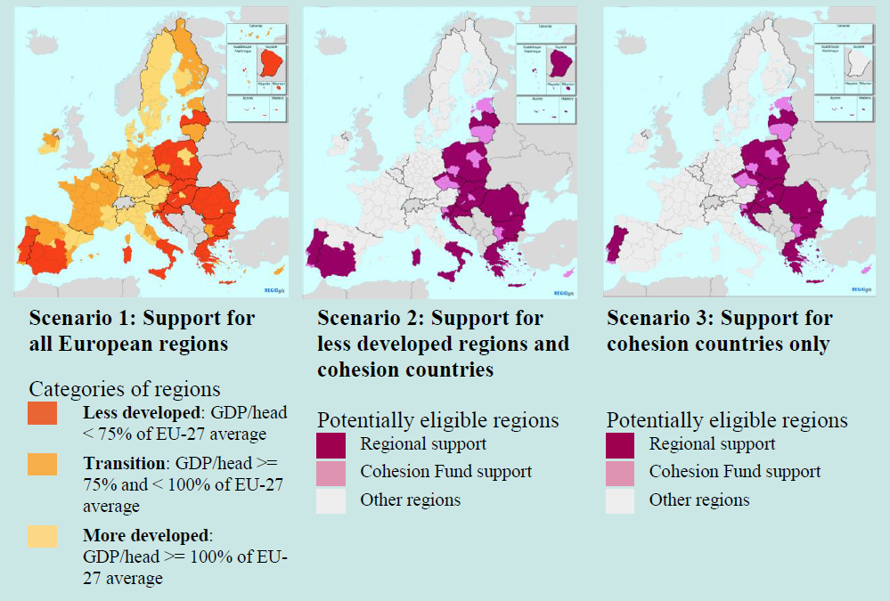
Cohesion Policy
Three Options still on the table!
Substantial reduction still possible
Need for continous pressure for the #CohesionAlliance

Slide 14
Not all that‘s in Cohesion Policy is Cohesion Policy:
Problem of top slicing Cohesion Policy
Structural Reforms Support
Connecting Europe Facility
EFSI 3.0
Cohesion Policy

Slide 15
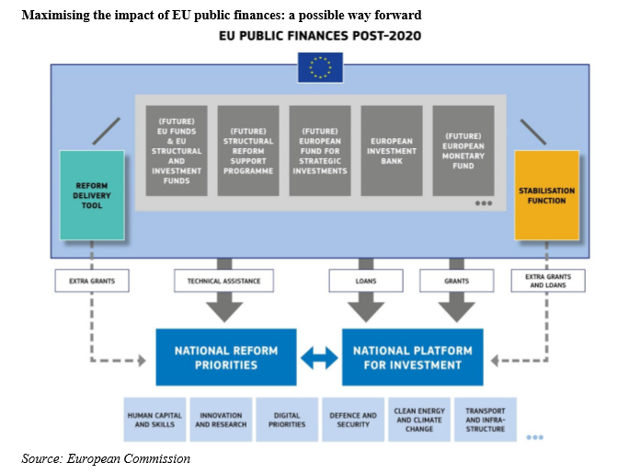
Budgetary Instruments for the EMU:
Structural Reform Support Programme
Reform Delivery tool
ESIF
EFSI
EIB
EMF
Option 1: Reform delivery tool: „Money for Reforms“ outside ESIF
Option 2: Reform delivery via ESIF

Slide 16
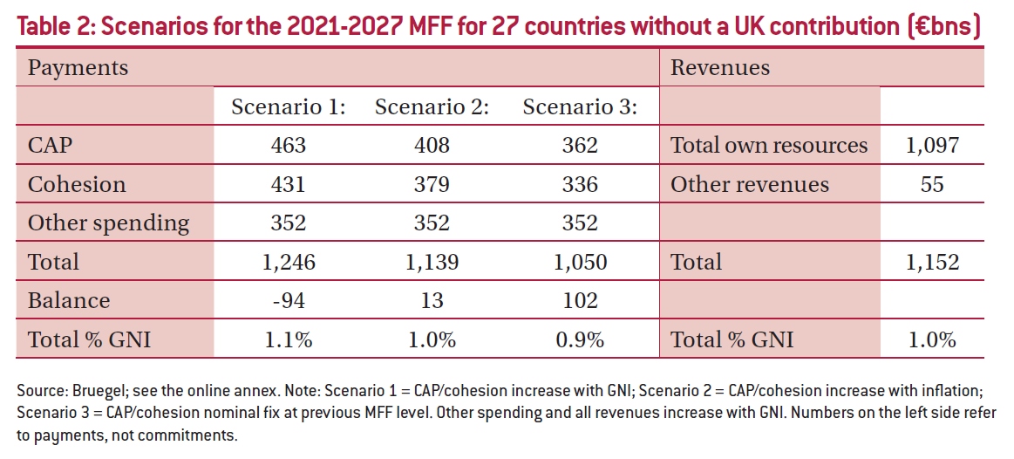
Different scenarios (Bruegel)
*
http://bruegel.org/wp-content/uploads/2018/03/PB-2018_01_correction.pdf

Slide 17
Agenda of the Council

Slide 18
Timetable in the Council (Leaders Agenda)
23.02.2018: Leaders debate in view of the MFF
18-19.10.2018 (tbc): European Council meeting on the next MFF
13-14.12.2018 (tbc): European Council meeting on the next MFF
9.05.2019 (tbc): European Council meeting on the final agreement on the next MFF

Slide 19
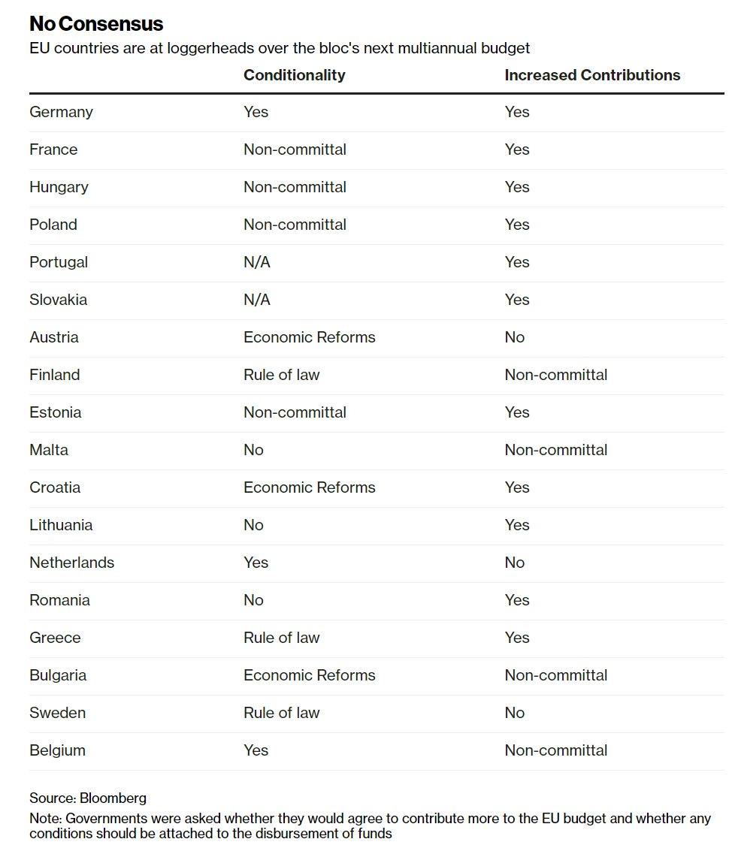
Results of the Leaders debate
Main points of disagreement:
Conditionalities (rule of law; structural reforms)
Link to migration
Budget for the EURO-Zone
Overall size of the EU Budget
Future focus of the EU Budget

Slide 20
Timetable of the
European Parliament

Slide 21
Next steps within the European Parliament
28.06.2018: Conference of Presidents on final referral of programmes to committees
06.09.2018: Conference of Presidents on political priorities
02/2019: Council sends saisine with the agreement on MFF/OR to Parliament
04/2019: Last plenary before European Elections – last possibility for votes on MFF /
OR package and for plenary proceedings with regard to the multiannual programmes

Slide 22
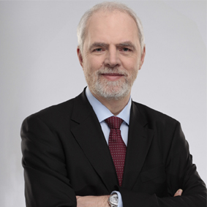
Key messages from the Olbrycht/Thomas report about the next MFF*
European added value should be one of the main principles guiding the EU institutions when
deciding about the type of spending in the next MFF
the next MFF should build on the Union’s well-established policies and priorities fostering
economic, social and territorial cohesion,
climate-related spending should be significantly increased compared to the current MFF
and reach 30 % as soon as possible and at the latest by 2027
continuous support for existing policies, in particular the long-standing EU policies enshrined in the Treaties, namely the common agricultural and fisheries policies, and cohesion policy; rejects any attempt to renationalise these policies
substantially scale up Research Framework Programme and Erasmus+
additional political priorities should be coupled with additional financial means
estimates the required MFF expenditure ceilings at 1.3 % of the GNI of the EU-27,
the MFF’s duration to move progressively towards a 5+5 period with a mandatory mid-term revision, however the next MFF should be set for a period of seven years (2021-2027), including a mandatory mid-term revision,
to ensure a full carry-over of payment margins through the Global Margin for Payments across the whole MFF
Calls for a far-reaching harmonisation of the rules with the aim of creating a single rulebook for all EU budgetary instruments
*
http://www.europarl.europa.eu/sides/getDoc.do?pubRef=-//EP//NONSGML+TA+P8-TA-2018-0075+0+DOC+PDF+V0//EN

Slide 23
... and the CoR?

Slide 24
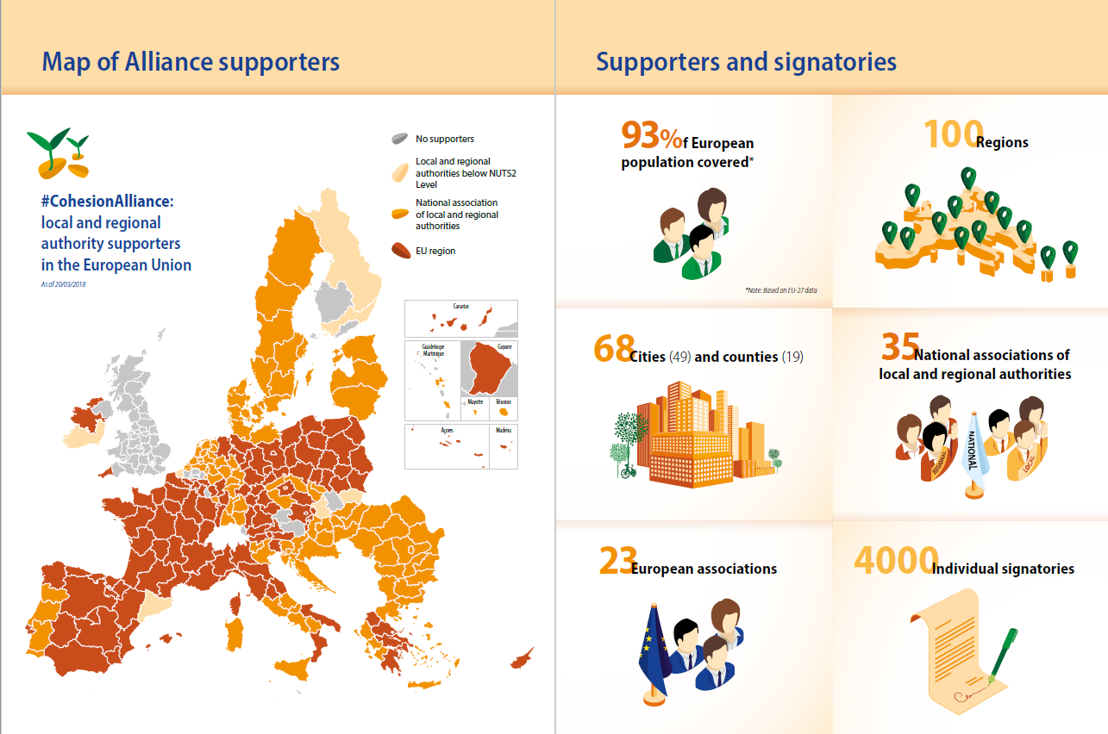

Slide 25
Timetable within the CoR (indicative)
22-23 March 2018: Plenary Session – discussion with MEP Olbrycht on the state of play of preparation of the next MFF (EP resolution on the MFF)
27 April 2018: 18th COTER meeting: appointment of a rapporteur for an opinion on the upcoming MFF proposals (similar in other CoR Commissions)
16-17 May 2018: CoR Plenary Session with the opportunity for a first response to the MFF proposal of the European Commission with Commissioner Oettinger and Commissioner Cretu
6-7 June 2018: external COTER/Bureau meeting in Sofia on "Implications of the MFF proposal for local and regional authorities";
25 September 2018: 20th COTER meeting: first discussion and adoption of the CoR opinion on the next MFF
5-6 December 2018: CoR Plenary Session – adoption of the CoR opinion on the MFF proposal (tbc)

Slide 26
Many thanks for your attention!
Thomas Wobben
European Committee of the Regions
Thomas.Wobben@CoR.Europa.EU

